Slide 1
What states Benefit from Federal food assistance programs the most, and does it affect obesity/diabetes?
By: Group Name Here
Allison, Clint, Henry, Zahra

Slide 2

RESEARCH QUESTIONS

Slide 3
Which ten states have the most WIC participants, based on population?
Which ten states have the most School Breakfast Program participants, based on population?
Which ten states have the most School Lunch Program participants, based on population?
Which ten states have the highest diabetes and obesity rates, based on population?

Slide 4
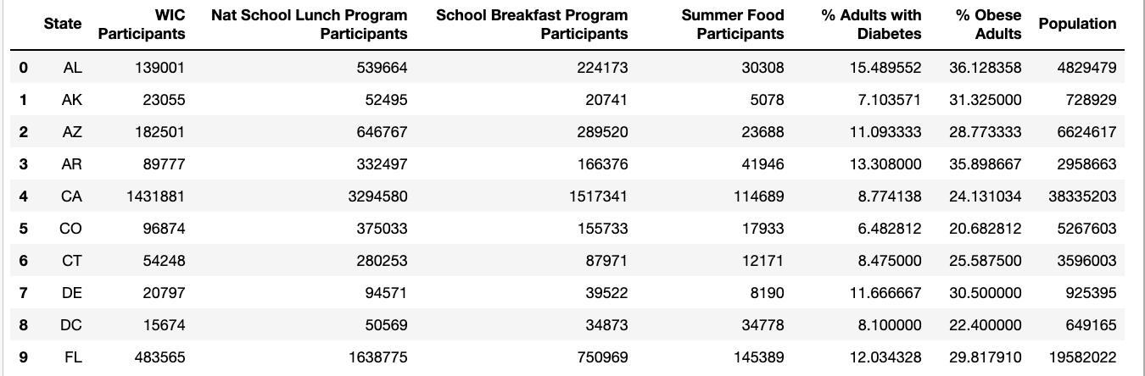
Data Snapshot

Slide 5
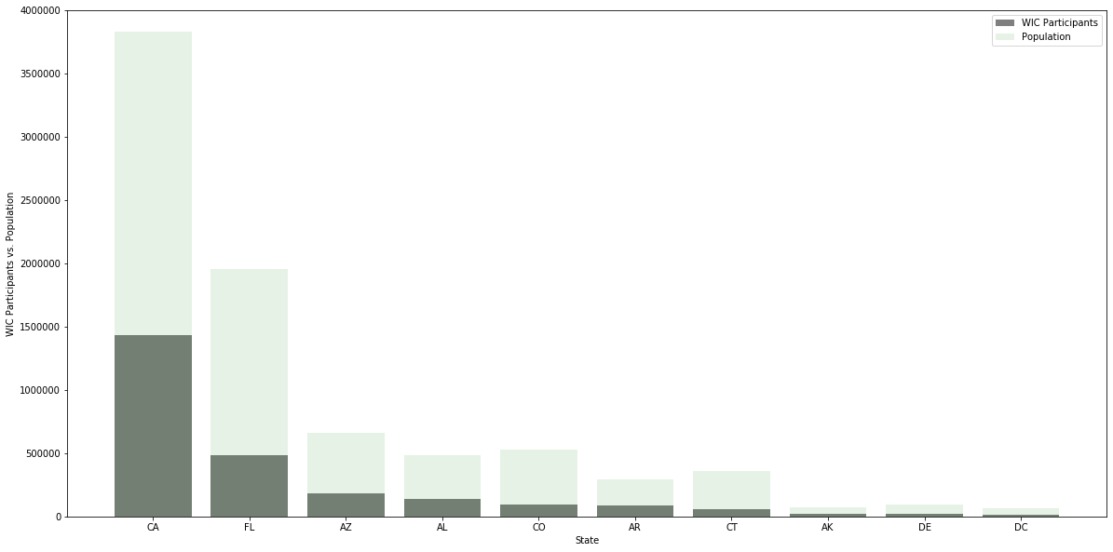
WIC Participation vs Population
Top 10 states for WIC Use:
CA (3.73%)
Ak (3.16%)
AR (3%)
Az (2.8%)
AL (2.9%)
FL (2.5%)
DC (2.41%)
DE (2.25%)
Co (1.8%)
CT (1.5%)

Slide 6
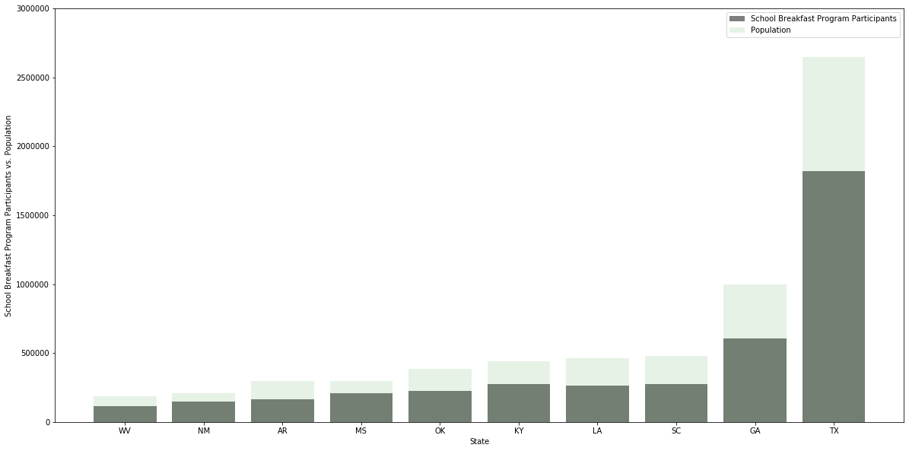
School Breakfast Program Participants vs Population
Top 10 states for Breakfast Use:
NM (7.11%)
Ms (7%)
TX (6.9%)
Wv (6.3%)
Ky (6.3%)
Ga (6.1%)
OK (6%)
LA (5.7%)
SC (5.7%)
AK (5.6%)

Slide 7
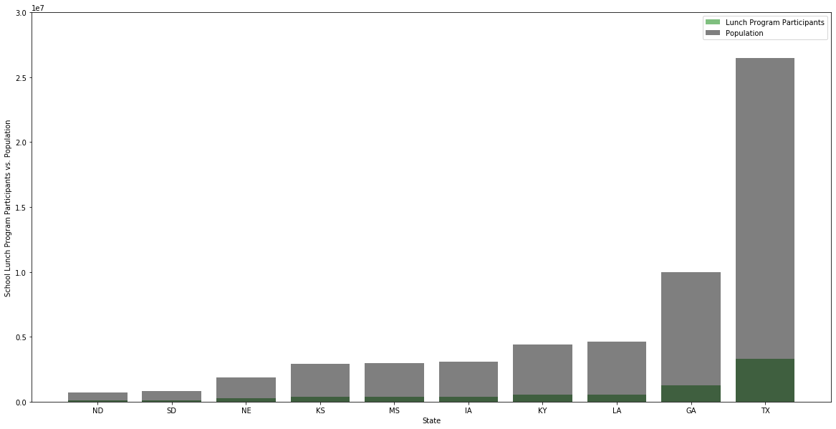
School Lunch Program Participants vs Population
Top 10 states for Breakfast Use:
MS (13.1%)
NE (13%)
SD (12.8%)
Tx (12.52%)
Ga (12.5%)
IA (12.43%)
LA (12.2%)
KY (12.1%)
ND (12.03%)
KS (12.02%)

Slide 8
Top 10 states for diabetes: GA (12.68%); OH (12.43%); NC (12.32%); FL (12%); mi (11.37%); PA (11.28%); IL (10.51%); TX (10.39%); NY (9.63%); CA (8.77%)
Association between obesity
and diabetes
Top 10 states for OBESITY:
OH (32.83%);
mi (32.1%); NC (31.5%); PA (31.45%);
GA (31.4%); IL (30%); FL (29.82%); TX (28.7%); NY (27.52%); CA (24.1%)
Based on population n and percentage of diabetes and obesity within each state, we can loosely associate the two chronic diseases with one another. We cannot claim to say the same individuals who are considered obese, also have diabetes.
Additional research will need to be done with patient-level data to link across diseases and ascertain whether one causes the other over time, increased risk for one if you are diagnosed with the other.

Slide 9
Summary
Based on the data there seems to be a direct association between obesity and diabetes. However, there is no correlation between the supplemental food programs and food-related diseases: Obesity and Diabetes
Top 10 States for Obesity
OH, MI, NC, PA, GA, IL, FL, TX, NY, CA
Top 10 States for Diabetes
OH, MI, NC, PA, GA, IL, FL, TX, NY, CA
Top 10 States for Lunch Assistance
ND, SD, NE, KS, GA, MS, IA, TX, KY, LA
Top 10 States for Breakfast Assistance
NM, WV, OK, SC, AR, GA, MS, TX, KY, LA,
Top 10 States for WIC Assistance
CA, FL, AZ, AL, CO, AR, CT, AK, DE, DC

